Slide 1
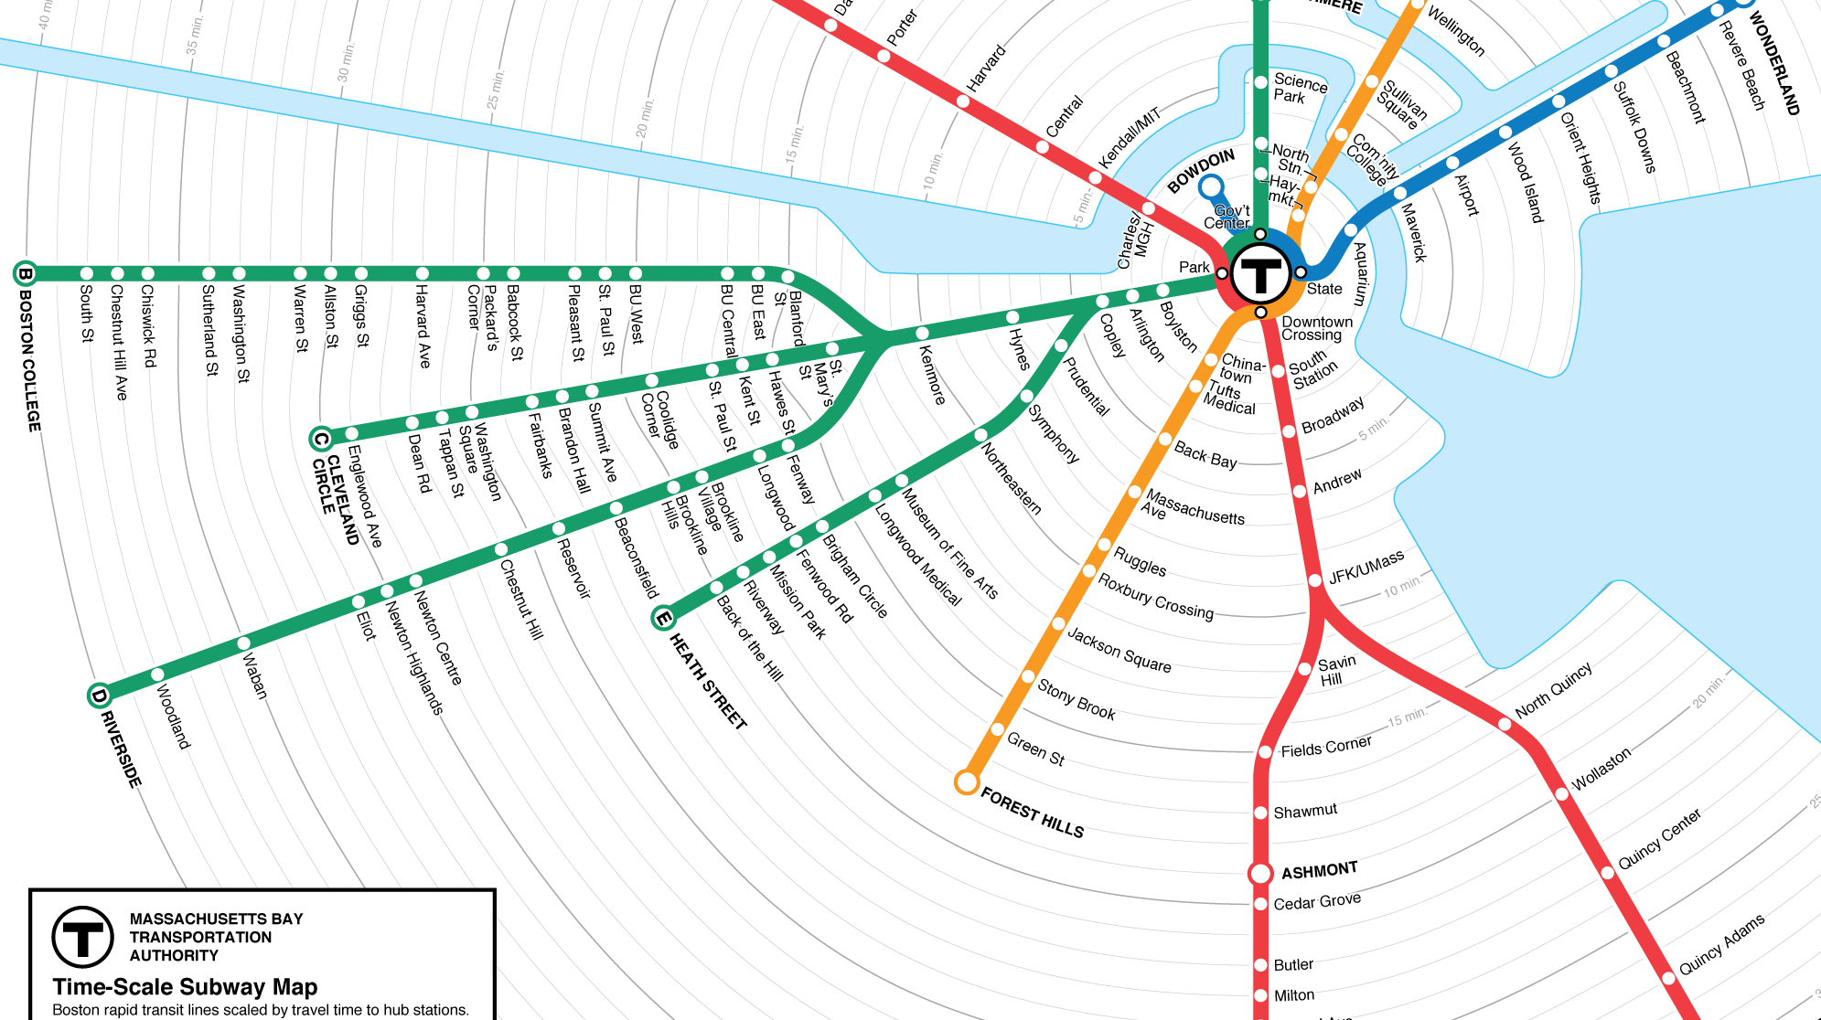
MBTA travel time prediction
Amal Krishna Radhakrishnan

Slide 2
Requirements
Learn Keras
Create a model to predict train arrival times.
The model should not require more than 5Gb of memory.
Mean Absolute Error within 2 minutes.
Mean Absolute Percentage Error within 20%.
Real-time dashboard with predicted arrival times for each stop.
System should be scalable to different cities.
System should be scalable to different transportation mediums.
System should be able to recommend drivers whether to go slow or fast based on the model to minimize train bunching.

Slide 3

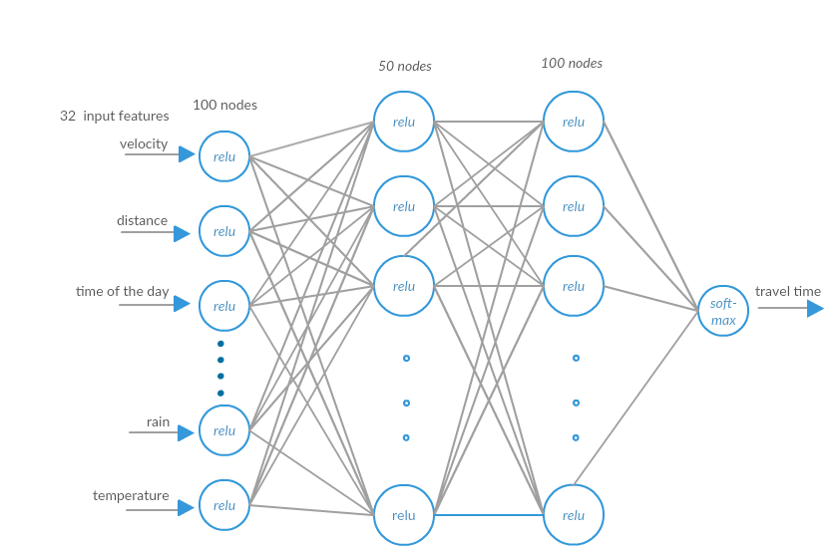

Models
Model 1 - OLS
statsmodels ordinary least squares(OLS)
Model 4 - DNN
Dense Neural Network(DNN)
3 Layer fully connected neural network.
Activation functions – RELU & Soft Max
Hyper Parameters-
Loss – mean absolute error
Optimizer – Adam
Dropout – 0.5
Validation Split – 0.2
epochs – 100
Batch Size – 100
Model 2 - GLM
statsmodels generalized linear model(GLM)
Model 3 - XGB
Regressor
Hyper Parameters –
n estimators – 50 (number of trees)
Learning rate – 0.05 (step size shrinkage used in update to prevent overfitting)
Max depth – 6 (maximum depth of a tree)
Notes:
XGBoost is an optimized distributed gradient boosting library designed to be highly efficient, flexible and portable.
Rectified Linear Unit. One way ReLUs improve neural networks is by speeding up training.
SoftMax - is a generalization of the logistic function that "squashes" a K-dimensional vector of arbitrary real values to a K-dimensional vector of real values, for, where each entry is in the interval, and all the entries add up to 1.

Slide 4
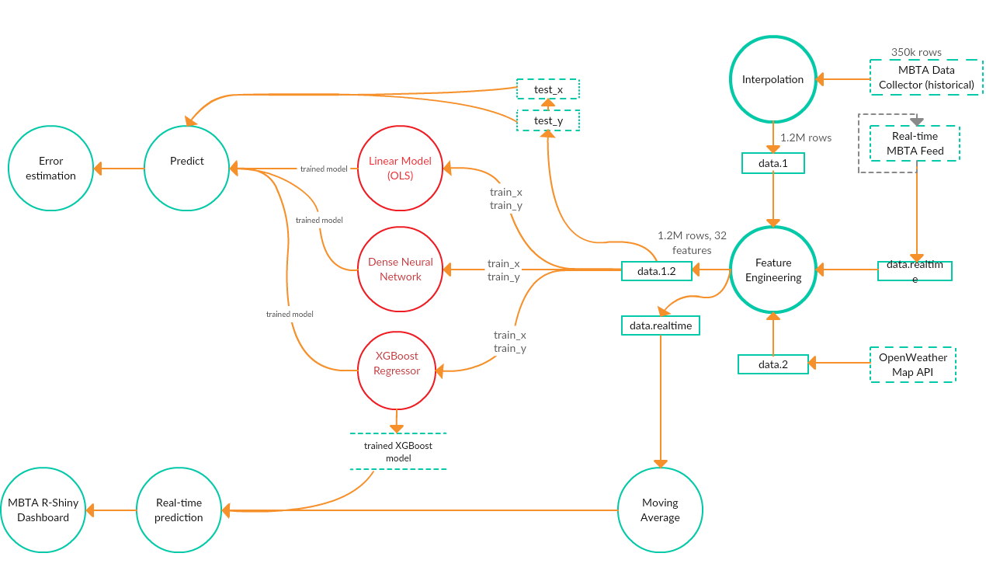
ML Pipeline

Slide 5
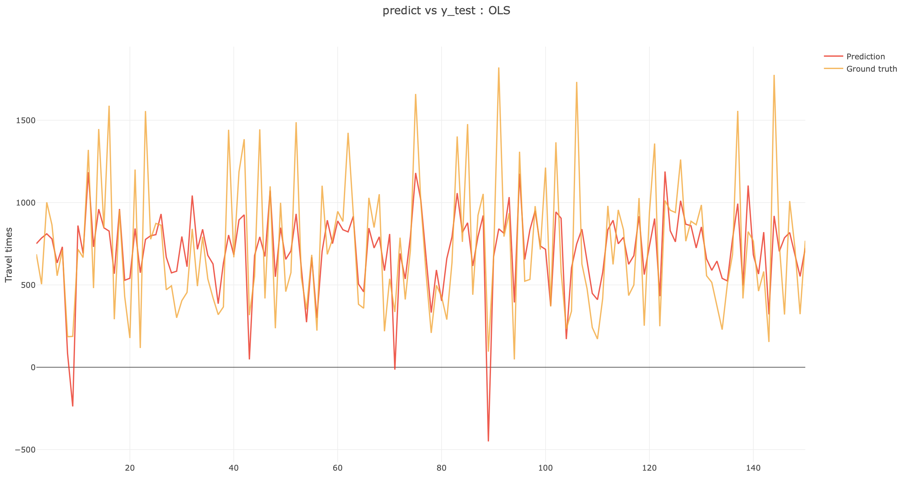
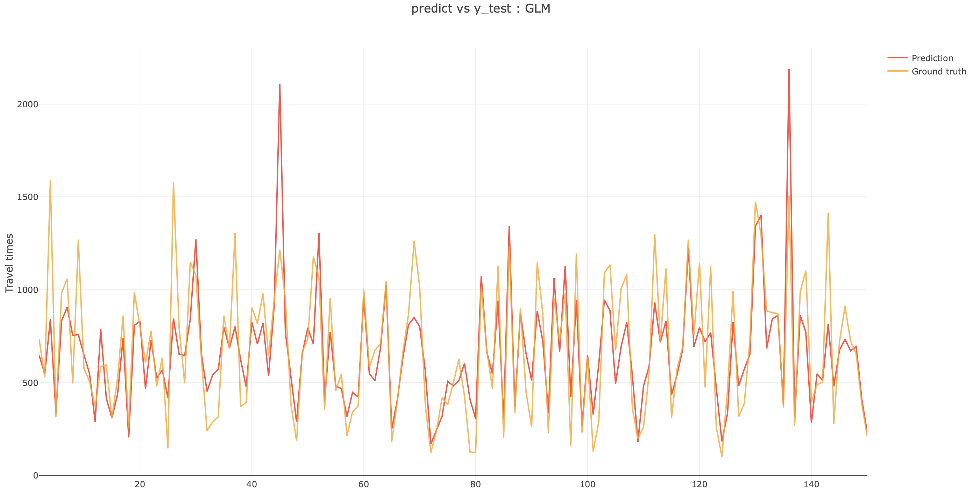
Linear models
GLM
OLS

Slide 6
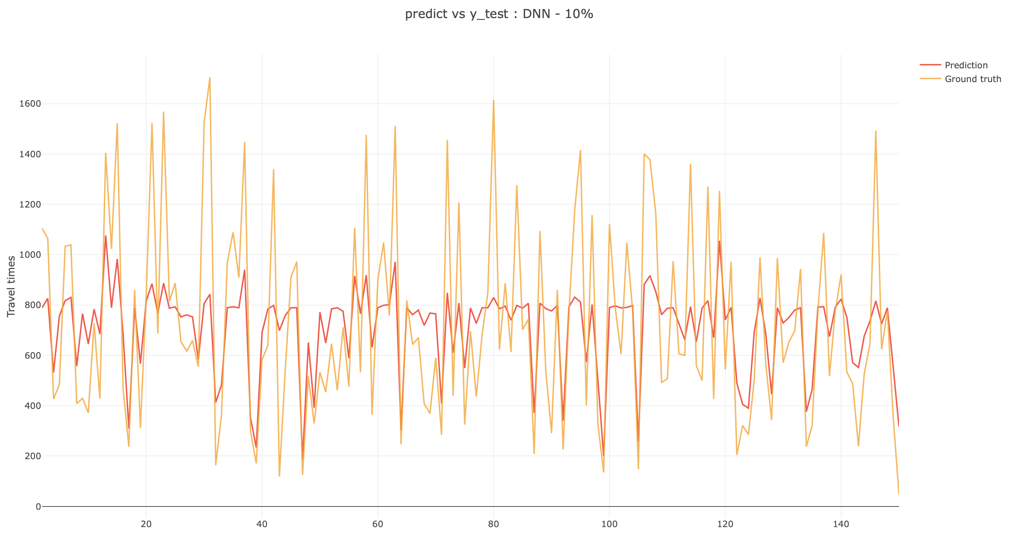
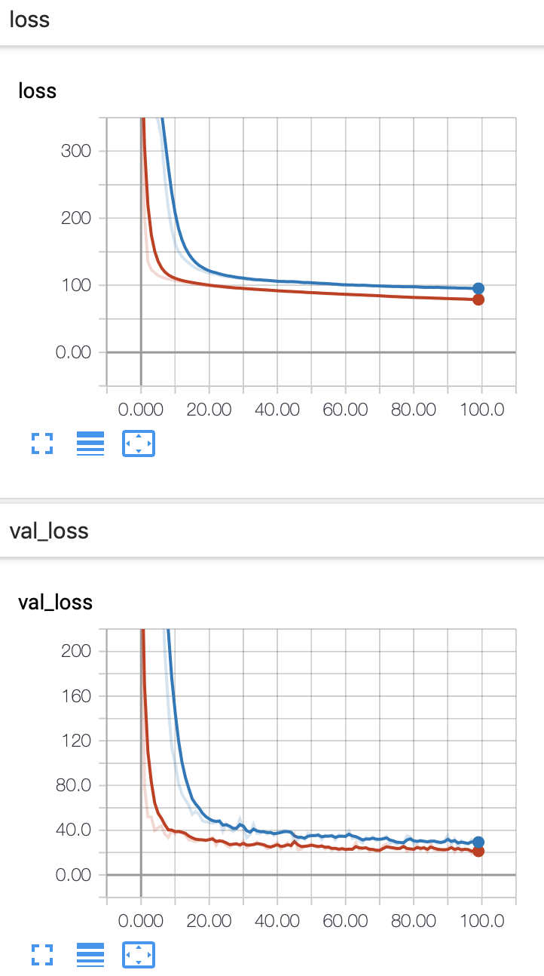
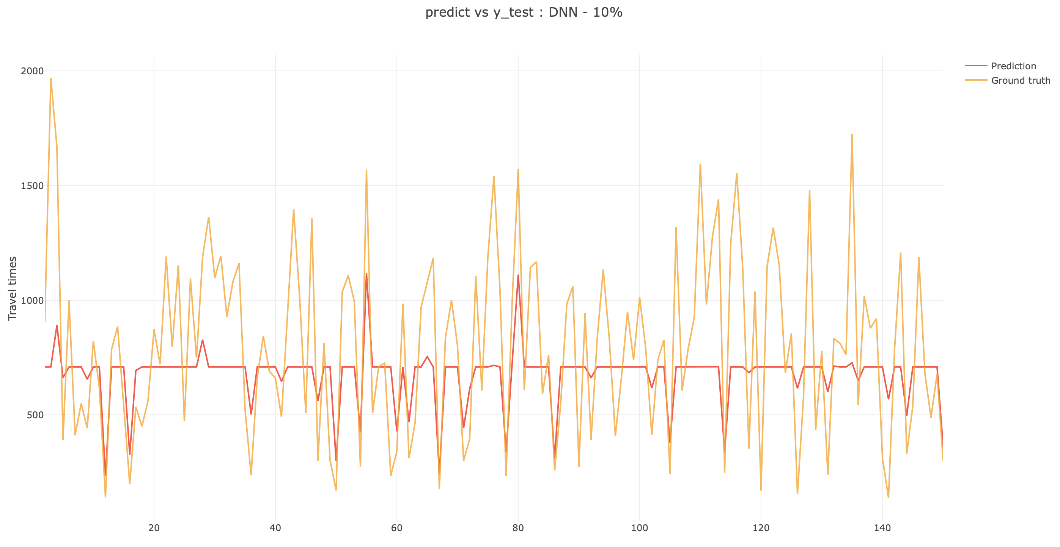
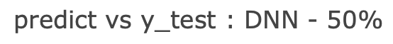
Dense Neural Network
--10% data –50% data

Slide 7
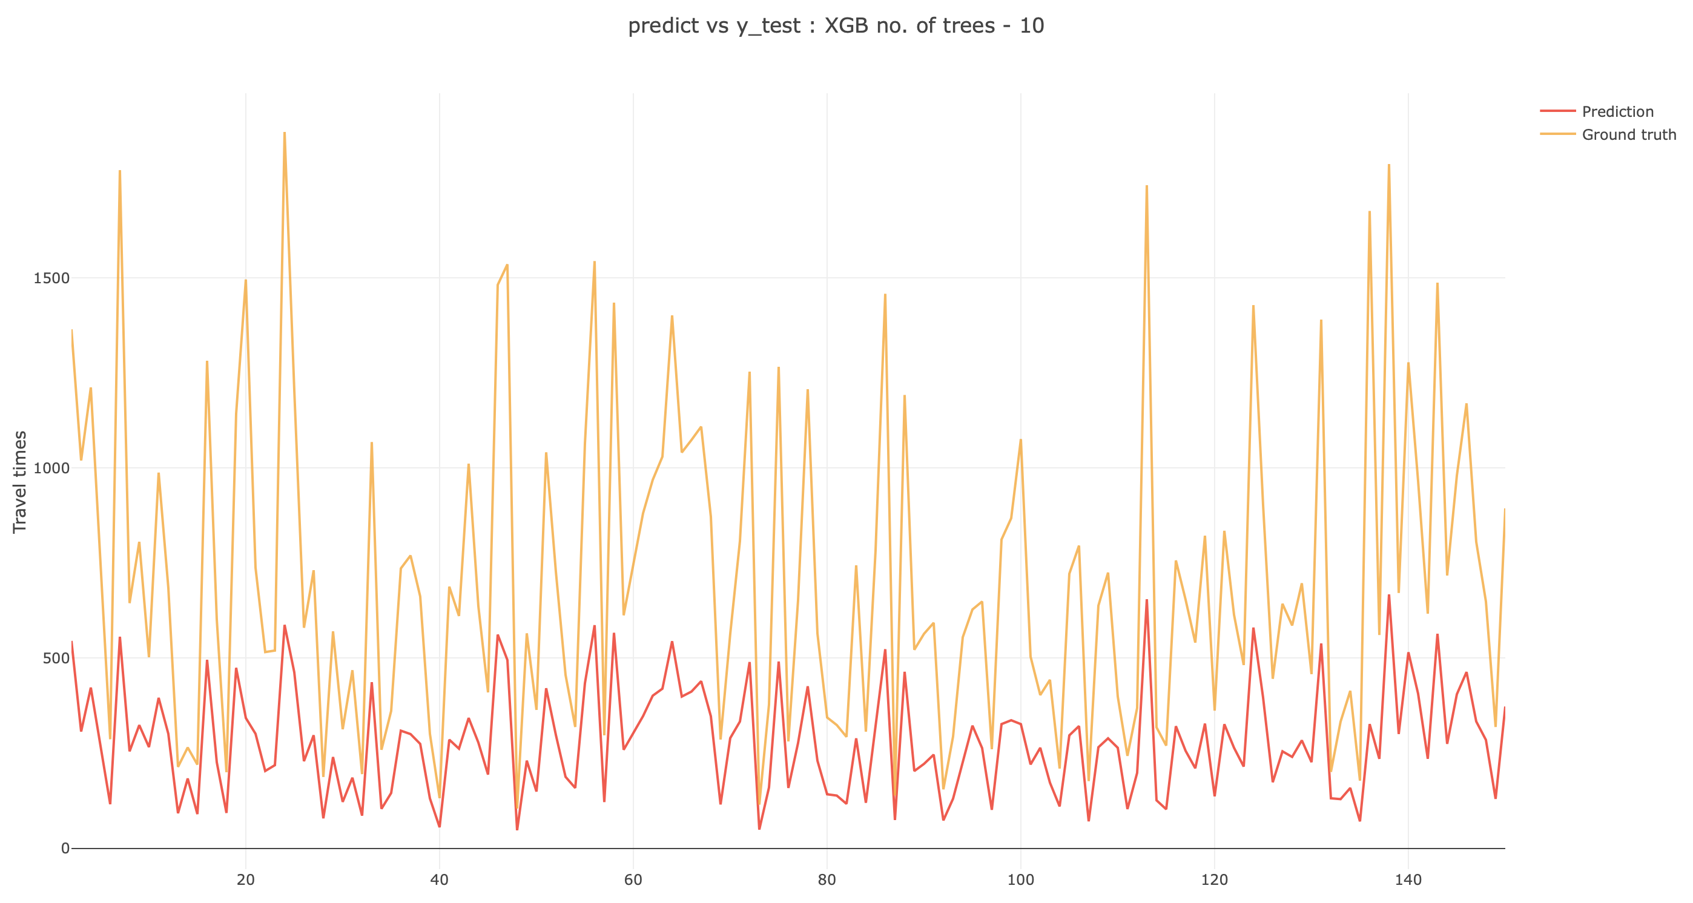
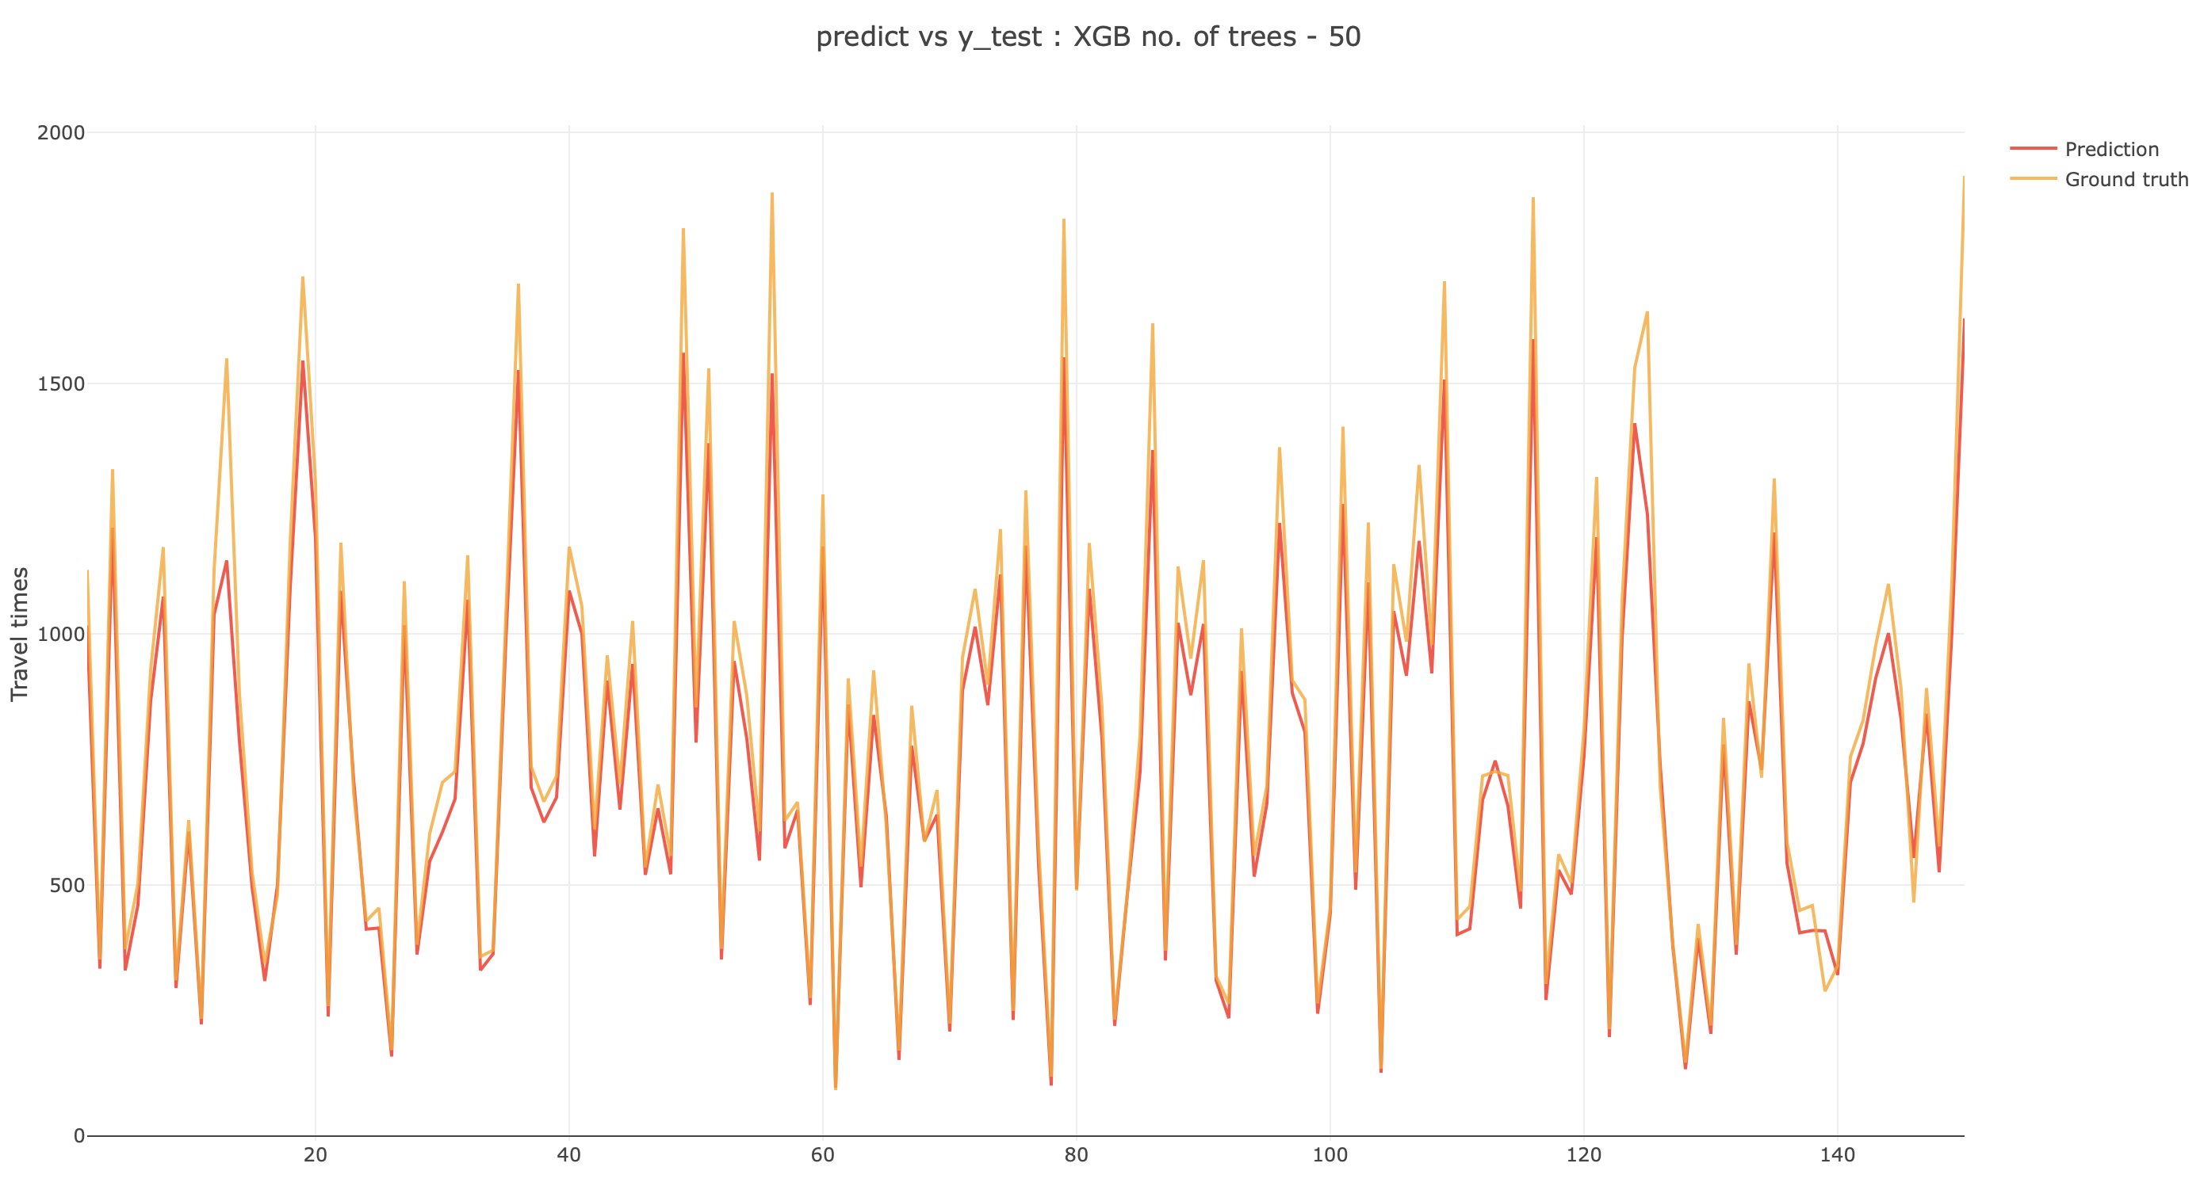
XGBoost Regressor

Slide 8
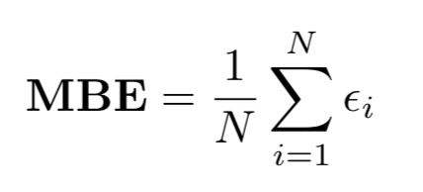
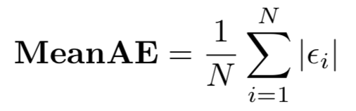
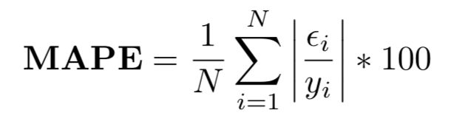
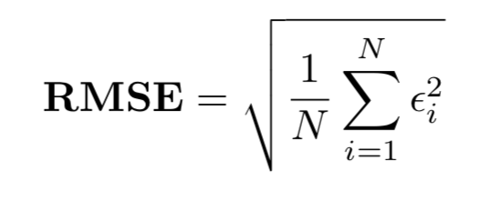
Error Metrics
Mean Bias Error measures the average difference between predict travel time and real travel time. Positive error and negative error will cancel out.
Mean Absolute Error measures the average derivation of prediction from real travel time.
Mean Absolute Percentage Error measures the average percentage derivation from real travel time.
Root Mean Squared Error measures average derivation. Compared to Mean Absolute Error, RMSE puts large weights on large errors.

Slide 9
Errors
 | MEANy (sec) | MBE | MAE (sec) | MAPE (%) | RMSE
OLS.all | 710.76 | -1.04 | 194.08 | 44.21 | 250.99
GLM.all | 712.5 | 7.15 | 283.43 | 38.56 | 5936.15
XGB.all | 711.98 | 54.8 | 58.79 | 7.7 | 83.77
DNN.10% | 713.26 | -7.97 | 217.94 | 43.06 | 273.21
DNN.50% | 712.77 | 38.41 | 248.63 | 45.7 | 320.07
DNN.all | 713.14 | 11.55 | 268.74 | 53.45 | 338.08

Slide 10
Errors
Route | MEANy (sec) | MBE | MAE (sec) | MAPE (%) | RMSE
Red Line | 756.85 | 58.12 | 63.12 | 7.79 | 88.82
Green-B Line | 687.23 | 52.94 | 55.85 | 7.65 | 78.09
Green-C Line | 663.37 | 51.5 | 54.83 | 7.75 | 78.14
Green-D Line | 650.2 | 50.04 | 54.07 | 7.6 | 79.17
Time | MEANy (sec) | MBE | MAE (sec) | MAPE (%) | RMSE
11am-3pm (non - peak hours) | 712.34 | 54.53 | 58.69 | 7.74 | 81.35
4pm-8pm (peak hours) | 641.25 | 48.83 | 53.58 | 7.92 | 75.94

Slide 11
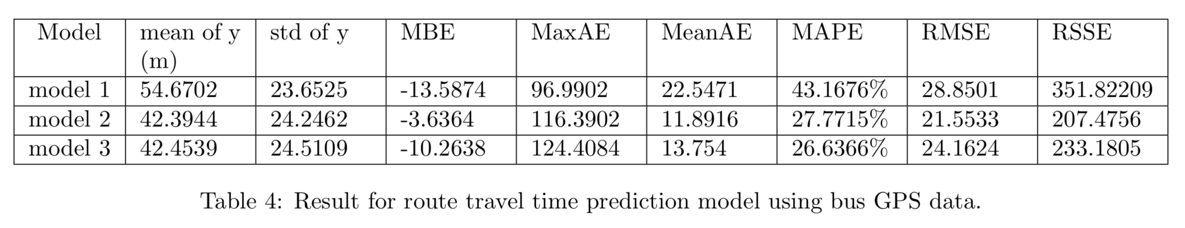
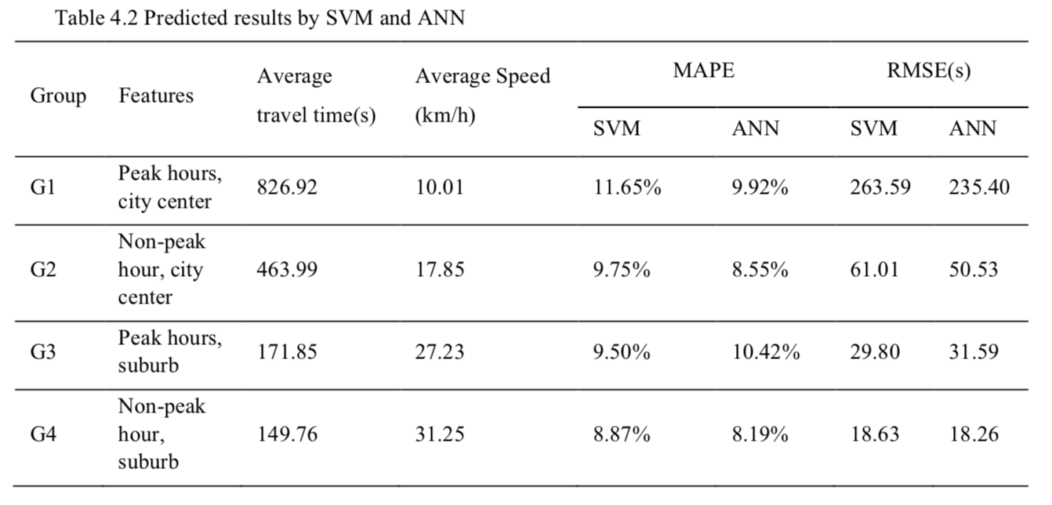
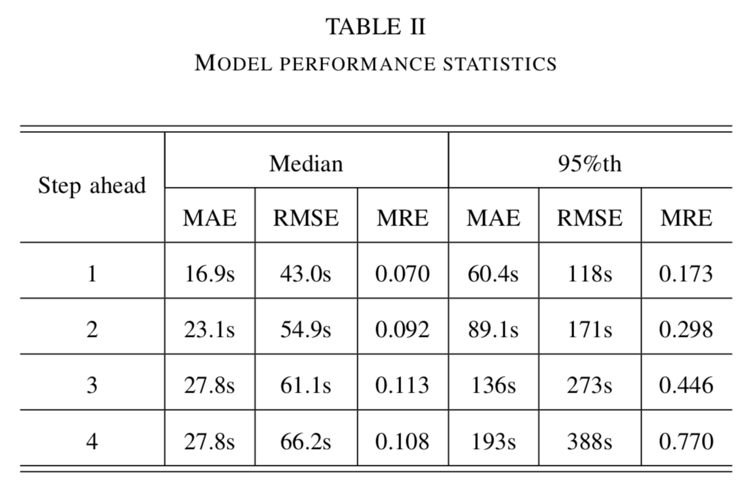
Benchmark
 | MEANy (sec) | MBE | MAE (sec) | MAPE (%) | RMSE
OLS.all | 710.76 | -1.04 | 194.08 | 44.21 | 250.99
GLM.all | 712.5 | 7.15 | 283.43 | 38.56 | 5936.15
XGB.all | 711.98 | 54.8 | 58.79 | 7.7 | 83.77
DNN.all | 713.14 | 11.55 | 268.74 | 53.45 | 338.08
1. Bus Transit Time Prediction using GPS Data with Artificial Neural Networks
Fan Jiang, Carnegie Mellon University (Thesis) – 2017
Prediction based on 3 different 3 layer neural network.
3. A prediction model of bus arrival time at stops with multi-routes.
Tingting Yin, Gang Zhong, Jian Zhang, Shanglu He, Bin Ran. School of Transportation, Southeast University, World Conference on Transport research. WTRC 2016 - Shanghai
Prediction model based on ANN and SVM to predict bus arrival time at an objective stop with multi-routes.
2. Travel Time Prediction with LSTM Neural Network,
Yanjie Duan, Yisheng and Fei-Yue Wang. 2016 IEEE 19th International Conference on Intelligent Transportation Systems

Slide 12
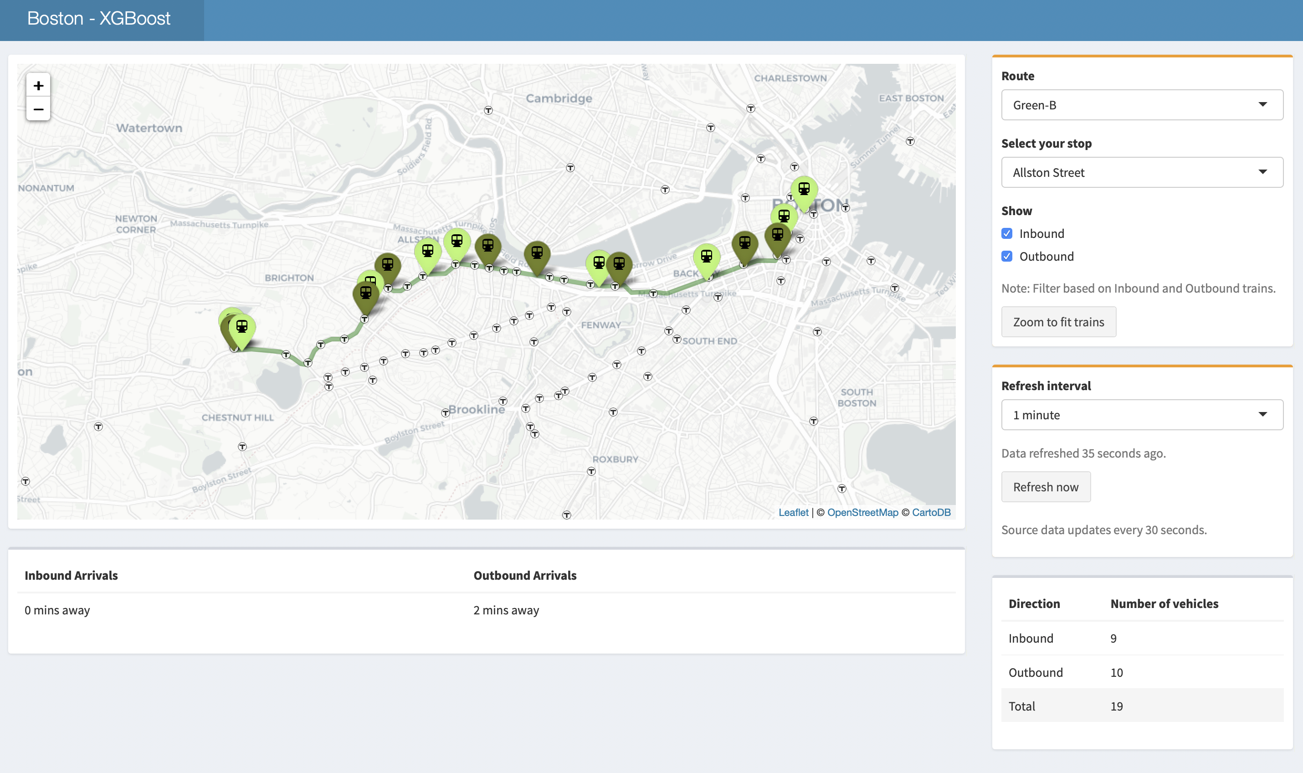
Implementation

Slide 13
What did not work
Dense Neural Network - I believe LSTM networks would be a better fit for this problem.
GLM - High RMSE shows that the model does not do well to predict the outliers. This is bad for the problem statement as we want to avoid the person missing the train.
Failed to get historical traffic information.
Failed to integrate Ashmont section of Red line.
No seasonality effect.

Slide 14
What worked
Keras, Plotly
XGBoost Regressor - model performed reasonably well with the hold-out test data. Playing with the hyper parameters had a significant impact in reducing the errors.
Integrating predictions to a RShiny dashboard
Observations from the error by route and peak hours.

Slide 15







Technologies used

Slide 16
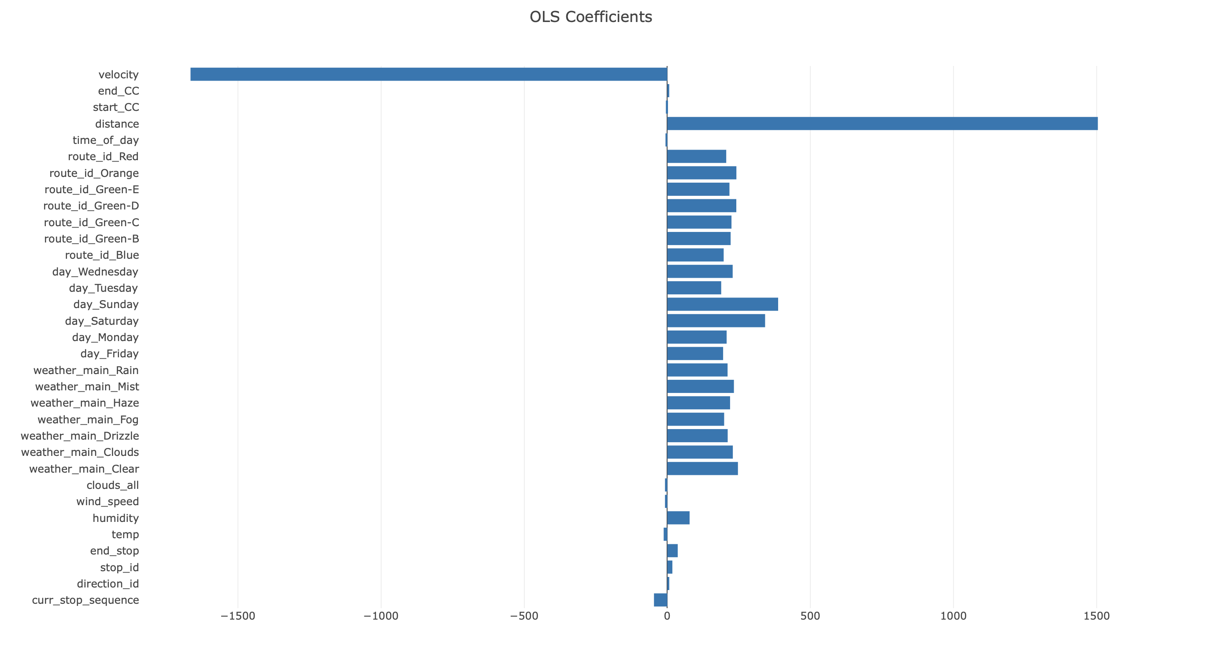
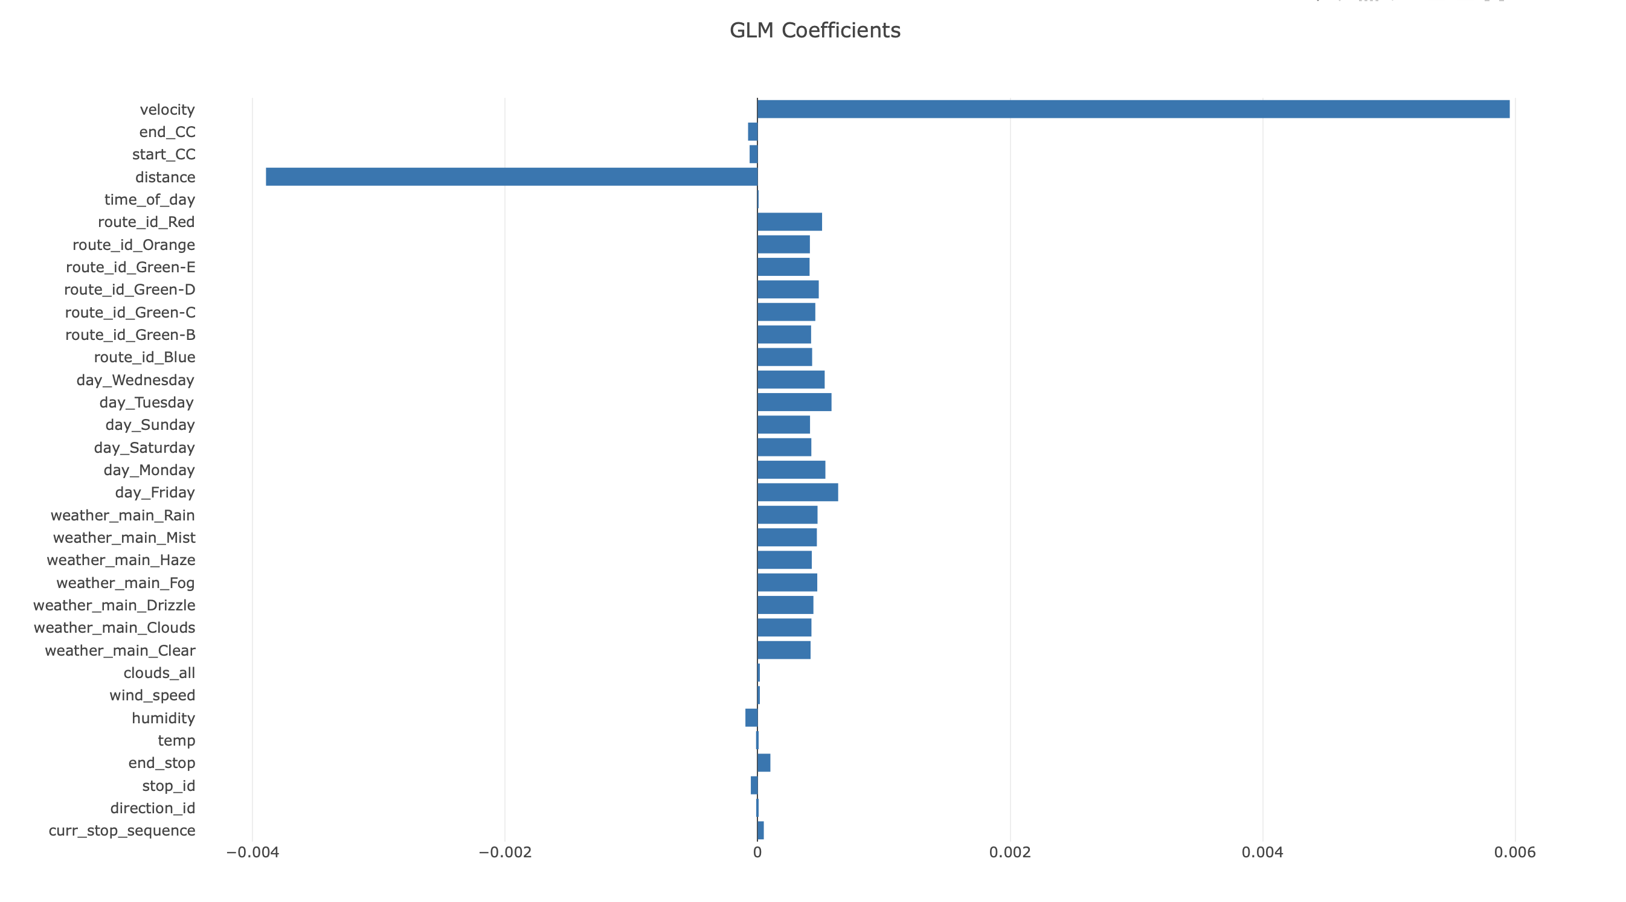
Appendix - Coefficients

